Slide 1

Experiment-4
Dielectric Behavior of Barium Titanate
By :- Sheelendra Agnihotri, Course in-charge ESO205

Slide 2
Objective
To study the dielectric behaviour of Barium Titanate upon its phase transformation with heating and cooling cycles and calculate its Curie temperature.
Experiment Design
The dielectric behaviour of BaTiO₃ changes upon phase transition from Cubic to Tetragonal or vice versa. To achieve this, vary the temperature and note down the values of capacitance and after a temperature the capacitance trend starts to change. This change in dielectric behaviour at a temperature is the Curie temperature.

Slide 3
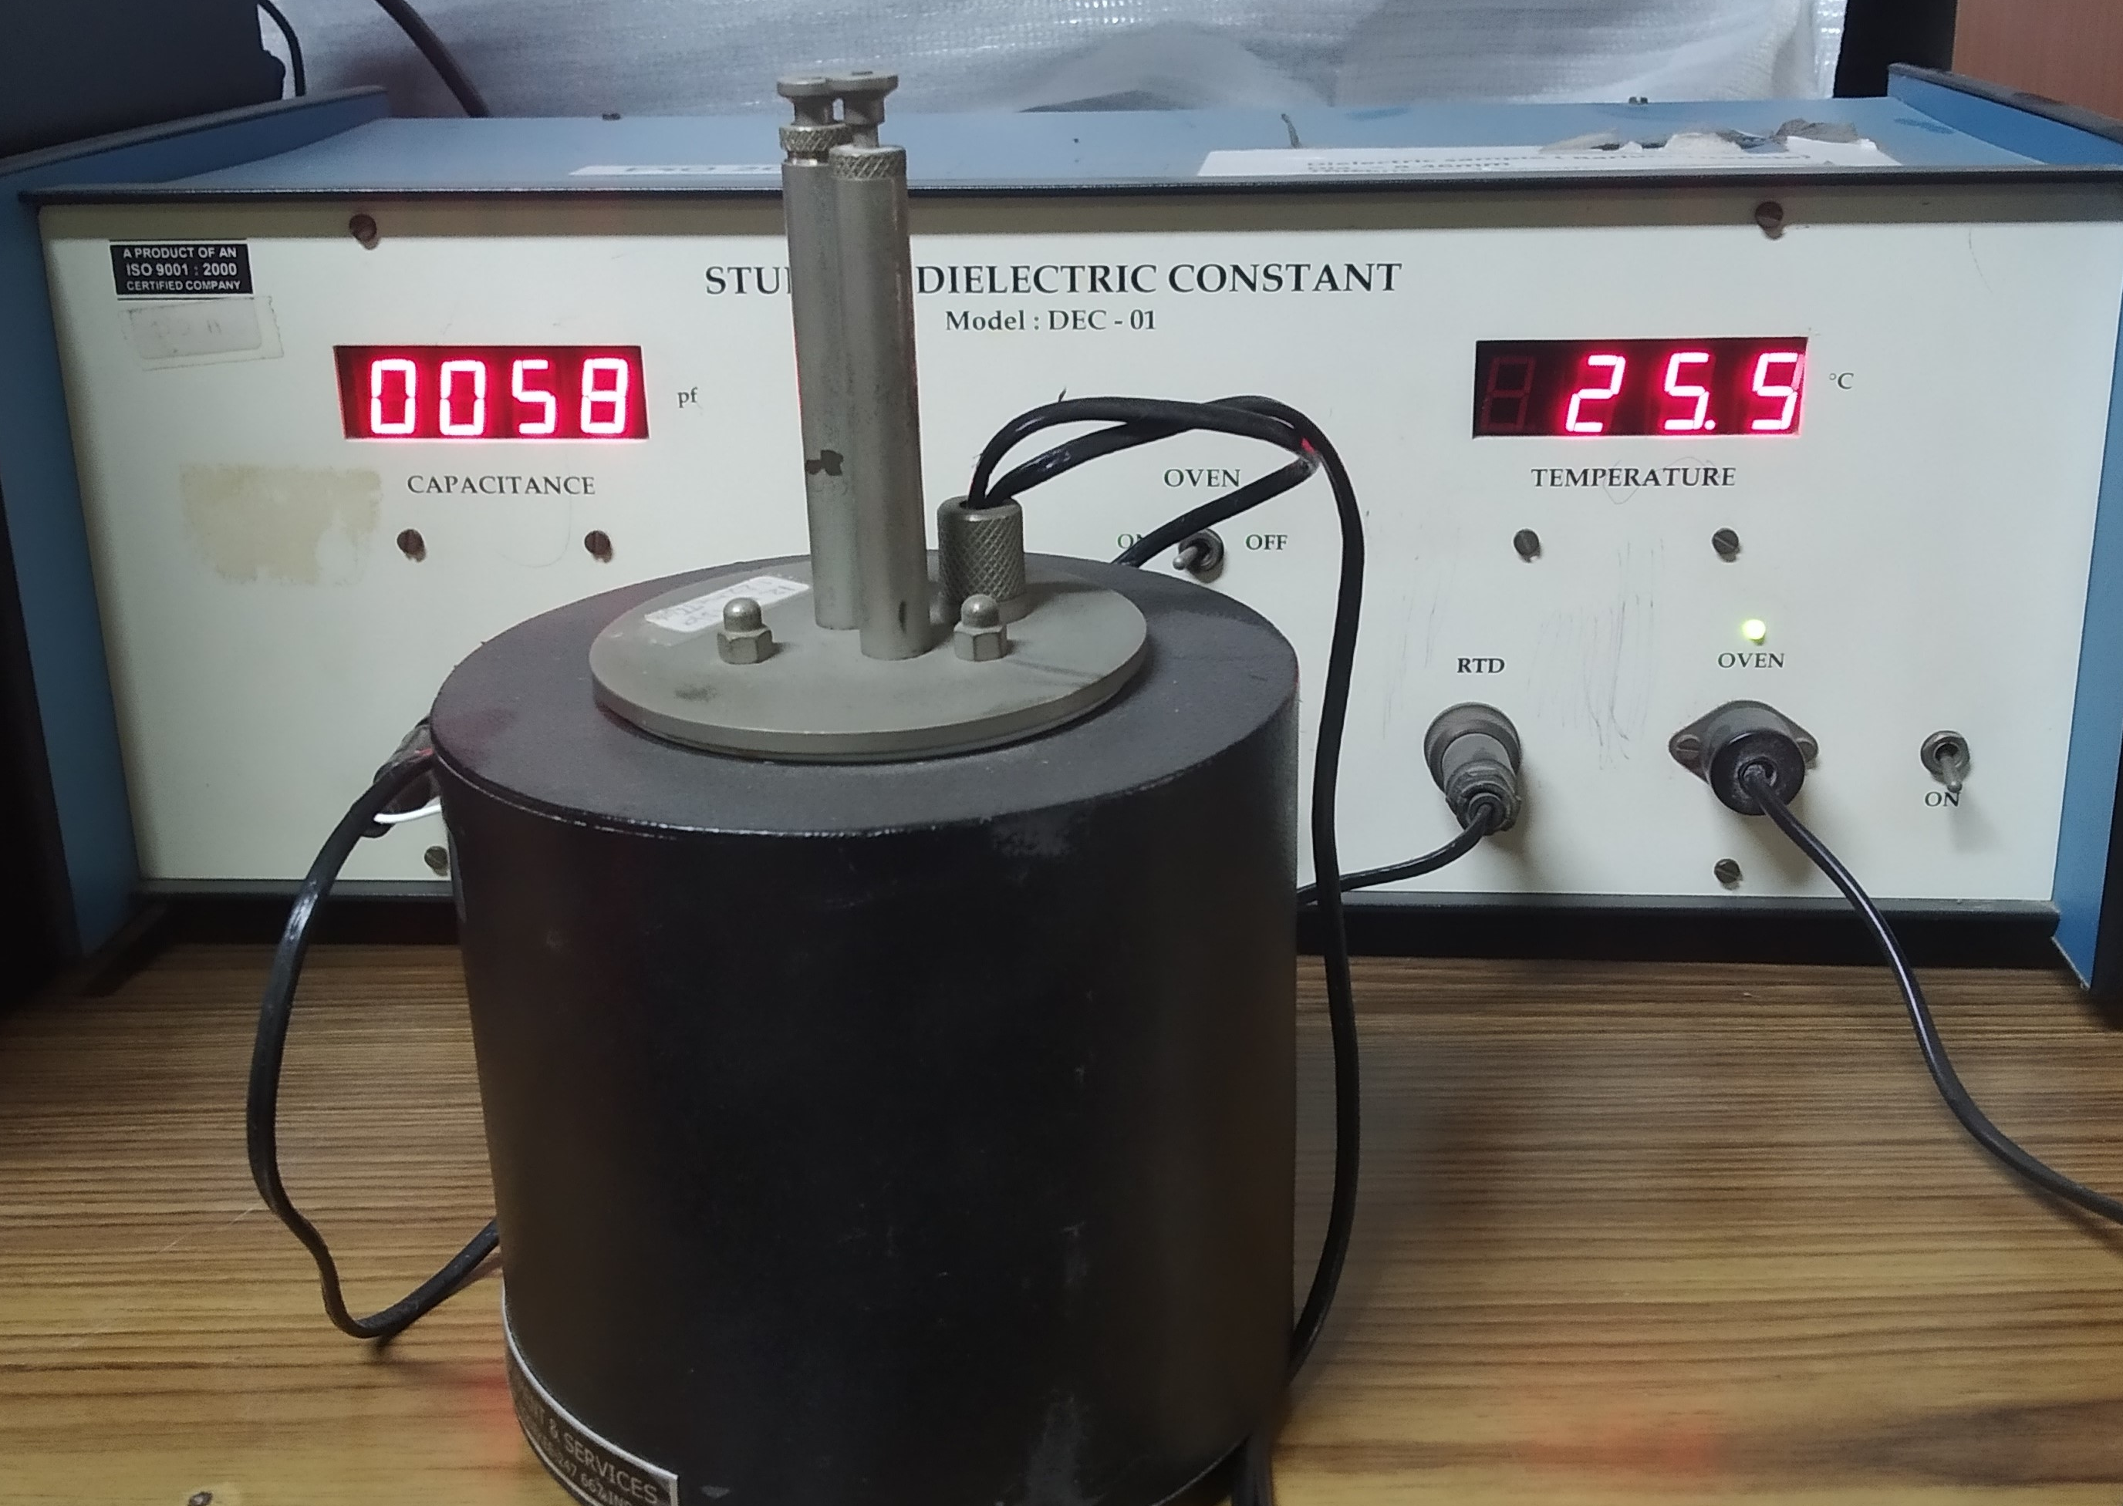
Dielectric Constant unit
PID Oven

Slide 4
Temperature (⁰C) | Capacitance (pF) | Dielectric constant | Capacitance during cooling | Dielectric constant
29.1 | 638 | 1448.26
30 | 642 | 1457.34
35 | 636 | 1443.72
40 | 629 | 1427.83
45 | 623 | 1414.21
50 | 615 | 1396.05 | 625 | 1418.75
55 | 616 | 1398.32 | 627 | 1423.29
60 | 617 | 1400.59 | 630 | 1430.1
65 | 618 | 1402.86 | 635 | 1441.45
70 | 625 | 1418.75 | 641 | 1455.07
75 | 631 | 1432.37 | 651 | 1477.77
80 | 642 | 1457.34 | 663 | 1505.01
85 | 659 | 1495.93 | 676 | 1534.52
90 | 667 | 1514.09 | 692 | 1570.84
95 | 594 | 1348.38 | 709 | 1609.43
100 | 706 | 1602.62 | 733 | 1663.91
105 | 731 | 1659.37 | 762 | 1729.74
110 | 752 | 1707.04 | 794 | 1802.38
115 | 799 | 1813.73 | 844 | 1915.88
120 | 875 | 1986.25 | 908 | 2061.16
122 | 914 | 2074.78 | 954 | 2165.58
124 | 959 | 2176.93 | 1000 | 2270
126 | 999 | 2267.73 | 1068 | 2424.36
127 | 1066 | 2419.82 | 1129 | 2562.83
128 | 1090 | 2474.3 | 1151 | 2612.77
129 | 1119 | 2540.13 | 1180 | 2678.6
130 | 1138 | 2583.26 | 1201 | 2726.27
131 | 1152 | 2615.04 | 1211 | 2748.97
132 | 1160 | 2633.2 | 1221 | 2771.67
133 | 1160 | 2633.2 | 1223 | 2776.21
134 | 1161 | 2635.47 | 1220 | 2769.4
135 | 1158 | 2628.66 | 1215 | 2758.05
136 | 1152 | 2615.04 | 1213 | 2753.51
137 | 1150 | 2610.5 | 1210 | 2746.7
138 | 1140 | 2587.8 | 1192 | 2705.84
139 | 1131 | 2567.37 | 1170 | 2655.9
140 | 943 | 2140.61 | 1150 | 2610.5
142 | 937 | 2126.99 | 990 | 2247.3
144 | 925 | 2099.75 | 951 | 2158.77
146 | 913 | 2072.51 | 931 | 2113.37
148 | 899 | 2040.73 | 910 | 2065.7
150 | 884 | 2006.68 | 895 | 2031.65
155 | 845 | 1918.15 | 850 | 1929.5
160 | 805 | 1827.35 | 816 | 1852.32
165 | 762 | 1729.74 | 739 | 1677.35
Test Data obtained at Lab

Slide 5
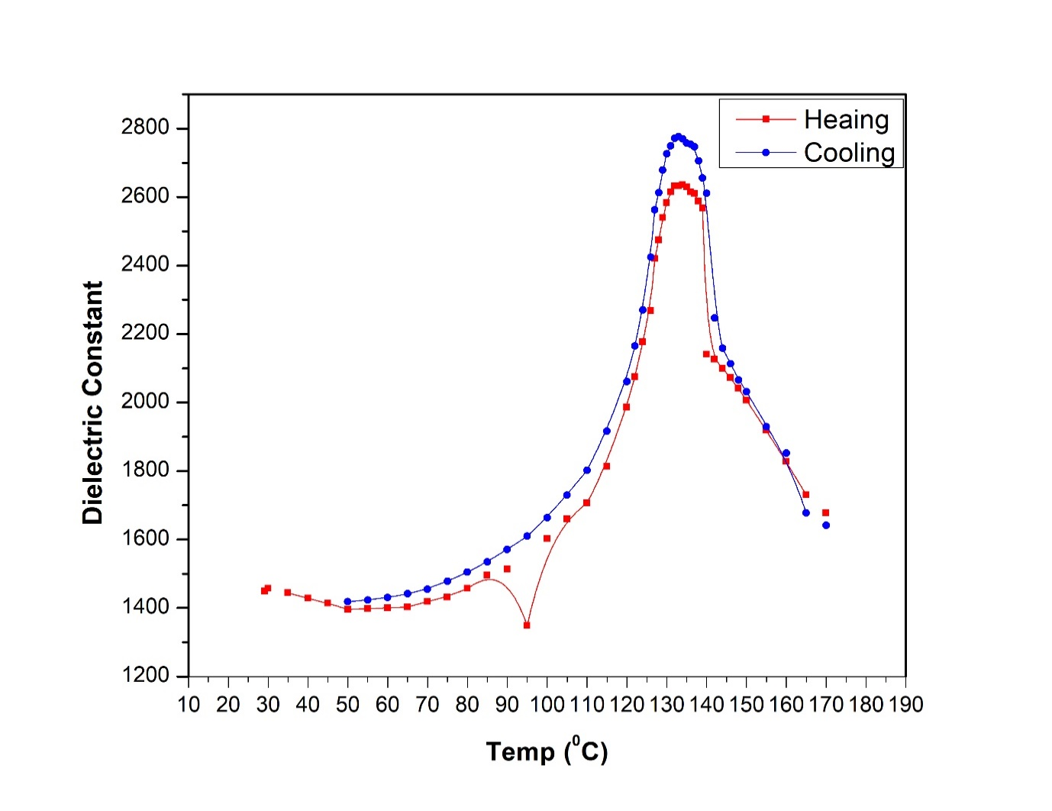
Dielectric constant VS Temperature

Slide 6

Result
The transition in the Capacitance is observed at 134⁰C upon heating and 133⁰C upon cooling. The curie temperature from this temperature is approximately
$\frac{134 +133 }{2 }={133.5}^{0}C$.
Therefore, BaTiO₃ has a phase transition temperature at around 133⁰C

Slide 7
Discussions:
Theoretical Curie temperature of BaTiO₃ is 120⁰C but the experimental is at 134⁰C. This difference in the Curie temperature is may be due to
Impurities present in the sample changes the curie temperature.
Variations in the applied electric field
Inherent errors in setting the temperature which leads to the non-equilibrium temperature between the metal contact and the BaTiO₃.

Slide 8
Thank you

